Slide 1
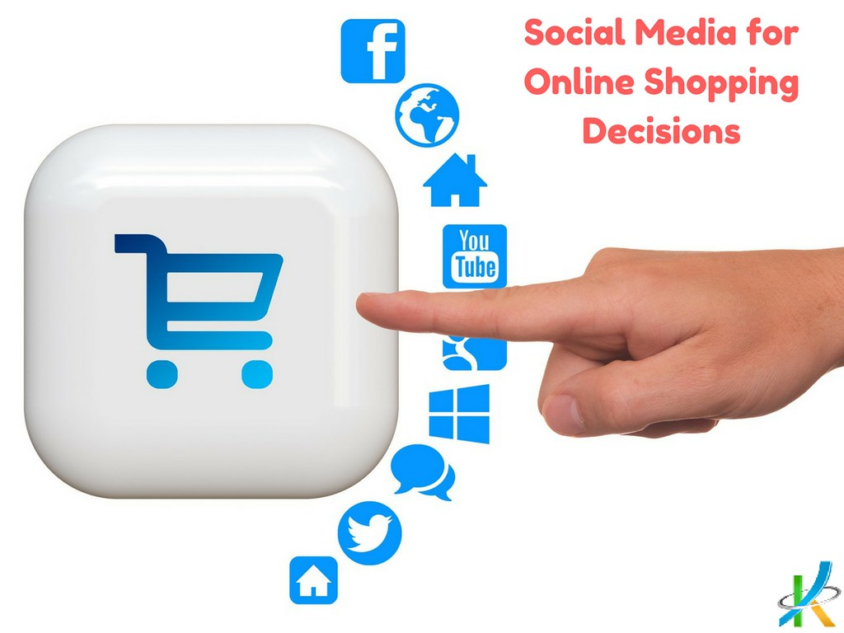
IMPACT OF SOCIAL MEDIA ON SHOPPING BEHAVIOR
SUBMITTED BY:- CHAITANYA KHARE UNDER GUIDANCE OF:
B.Sc.(Hons.) APPLIED STATISTICS AND ANALYTICS Dr. RASHMI AWAD
SCHOOL OF STATISTICS ASST. PROFESSOR

Slide 2
CONTENT
INTRODUCTION
OBJECTIVE
WORK FLOW
INSIGHTS
FINDINGS
CONCLUSION
1
2
3
4
5
6

Slide 3
INTRODUCTION
Social media used for peer-driven product information.
Consumers influence others through reviews and are influenced by psychosocial factors.
Key platforms include Facebook, Instagram, Twitter, and Pinterest.
Smartphones intensify social media's impact.
Social media is a constant companion throughout the consumer journey.
Examination of social media's frequency of use and its impact on consumer attention.
Exploration of the influence of internet influencers on shopping decisions.
Anticipation of uncovering the evolving landscape of shopping in the digital age.

Slide 4
OBJECTIVE
Identify the pattern of social media usage in the context of shopping behavior.
Examine the factors on social media platform that significantly influence consumer decisions.
Understand the role of user-generated content and peer recommendations in shaping purchasing choices.

Slide 5
WORK FLOW
DATA COLLECTION
DATA ANALYSIS
DATA VISUALIZATION
DATA INTERPRETATION

Slide 6
DATA COLLECTION
For this study, primary data have been used.
A structured questionnaire was designed containing a series of questions for the collection of primary data.
The first-hand data has been collected from the respondents who were the users of one or more social networking sites.
These respondents belong to different genders, age-groups, with different educational qualifications.
Data were collected from 154 respondents.

Slide 7
DATA ANALYSIS
Tool used: MS Excel
Statistical tools are used to analyses the data like chi-square analysis
Hypotheses were tested which were developed based on objectives of the study.
This statistical method helps us understand the connection between different categories of things.
It checks if there is a significant link between two categories, giving us insights into how they relate.
Our project is all about using this method to see how social media and shopping are connected.
By using this method, we want to find important patterns that can help make better decisions or plans.

Slide 8
DATA VISUALIZATION
For this, Power BI have been used.
It can connect to different types of data sources, like databases or cloud services, and turn raw data into easy-to-understand insights.
With Power BI, we can create cool and interactive reports with charts, graphs, maps, and tables. This makes it easier to see what's going on in our business.
It also lets you look at data in real-time, so you're always up to date. This is helpful for things like tracking performance or keeping an eye on important numbers.
One of the best things about Power BI is that it lets you share your reports and dashboards with others. This way, everyone in the team can stay on the same page and make decisions based on the latest information.

Slide 9

DATA ANALYSIS (CHI SQUARE TEST )
Assumptions:
It works with categorical data.
The data points must be independent.
Each expected count in the analysis should be at least 5.
Formula:
Where Oij is observed frequency and Eij is expected frequency
Degrees of Freedom:
Calculate the degrees of freedom (df) using: df=(r−1)×(c−1)
where r is the number of rows and c is the number of columns.
Interpretation:
Compare the calculated chi-square value with a critical value or check the p-value.
If the chi-square value is higher than the critical value or the p-value is less than 0.05, we reject the idea that the categories are independent.

Slide 10
HYPOTHESIS TESTING I
H01: There is no significant association between social media usage and shopping behavior.
P-value = 0.00007
Chi-square critical value from the table = 9.488 (5% level of significance)
Chi-square computed value = 24.29034
Degree of Freedom = 4
we reject the null hypothesis.
OBSERVED TABLE
Social Media Usage | Online | In-Store | Both | TOTAL
Frequently | 22 | 16 | 72 | 110
Occasional | 6 | 8 | 5 | 19
Non-User | 5 | 13 | 7 | 25
TOTAL | 33 | 37 | 84 | 154
EXPECTED VALUES
Social Media Usage | Online | In-Store | Both
Frequently | 23.57142857 | 26.42857143 | 60
Occasional | 4.071428571 | 4.564935065 | 10.36363636
Non-User | 5.357142857 | 6.006493506 | 13.63636364

Slide 11
HYPOTHESIS TESTING II
H02: There is no significant difference between the Age groups who purchase online.
P-value = 0.0085
Chi-square critical value from the table = 9.488 (5% level of significance)
Chi-square computed value = 13.6286
Degree of Freedom = 4
We reject the null hypothesis
OBSERVED TABLE
AGE GROUPS | Not influential | Somewhat influential | Very influential
10 to 20 | 4 | 36 | 3
20 to 30 | 10 | 57 | 9
30 to 40 | 6 | 7 | 6
40 to 50 | 4 | 5 | 1
50 to 60 | 3 | 3 | 0
EXPECTED TABLE
AGE GROUPS | Not influential | Somewhat influential | Very influential
10 to 20 | 11 | 44 | 4
20 to 30 | 10 | 57 | 9
30 to 40 | 6 | 7 | 6

Slide 12
INSIGHTS
This section consists of insight into data analysis of the Impact of Social Media on shopping and factors of online shopping are presented and analyzed.
GENDER
Information about gender from respondents is collected for understanding the perception of male and female about online shopping and their satisfaction level

Slide 13
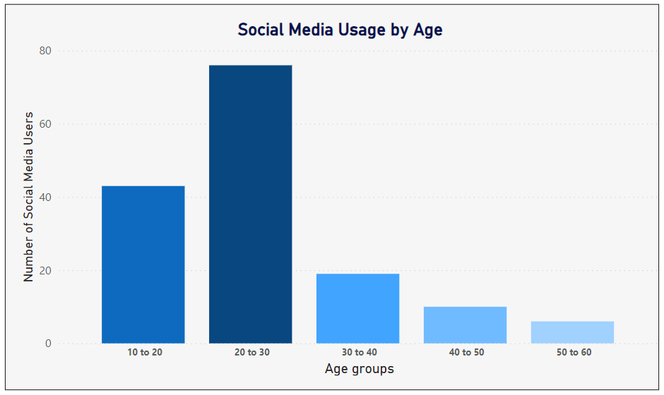
INSIGHTS
AGE
It shows 28% are from 10-20 age group,
49% are from 20-30 age group
12% is from 30-40 age group
7% from 40-50
4% from 50-60.

Slide 14
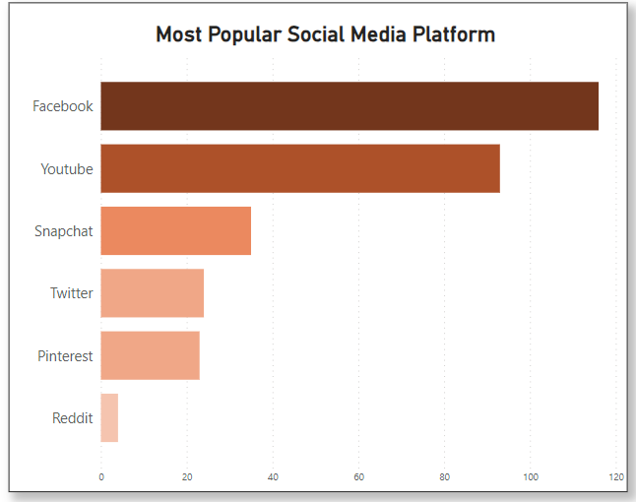
INSIGHTS
MOST PREFERRED SOCIAL MEDIA

Slide 15
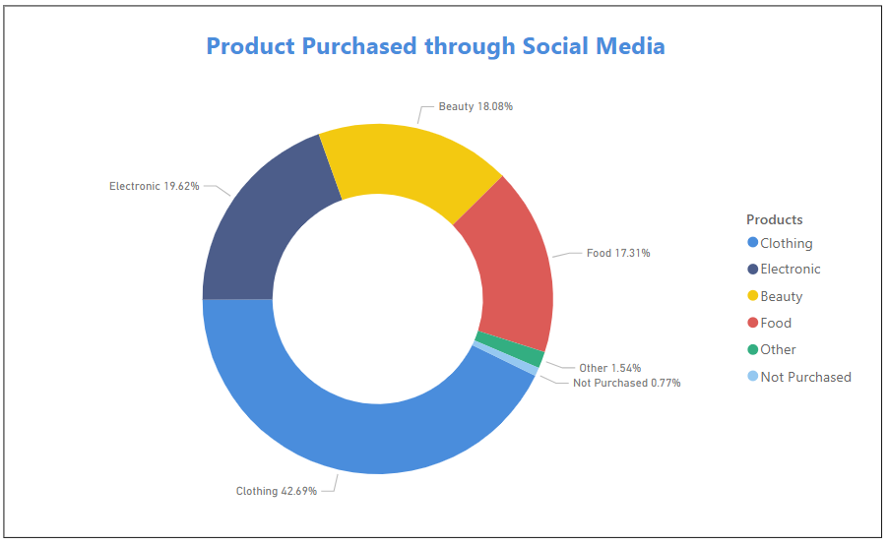
INSIGHTS
PRODUCT PURCHASED THROUGH SOCIAL MEDIA

Slide 16
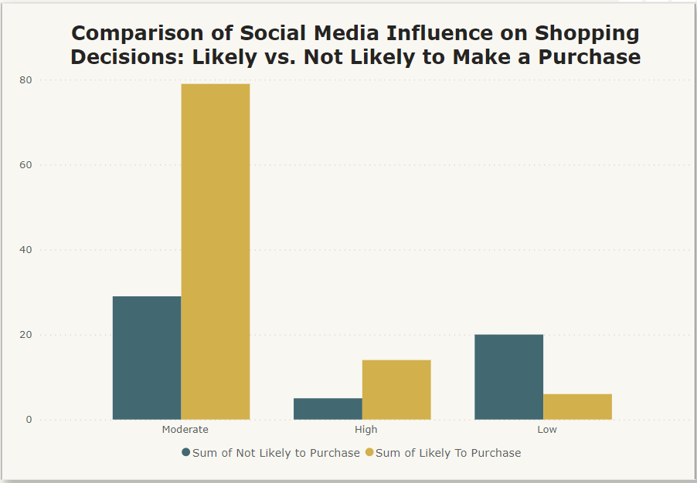
INSIGHTS
SOCIAL MEDIA INFLUENCE TO PURCHASE
' Likely to Make a Purchase' group has higher counts across high and moderate social media influence levels.
The most significant difference is observed in the 'Moderate' social media influence level,
'Not Likely to Make a Purchase' group has a notably lesser count
Overall pattern suggests that social media influence has a more pronounced impact on the 'Likely to Make a Purchase' group.

Slide 17
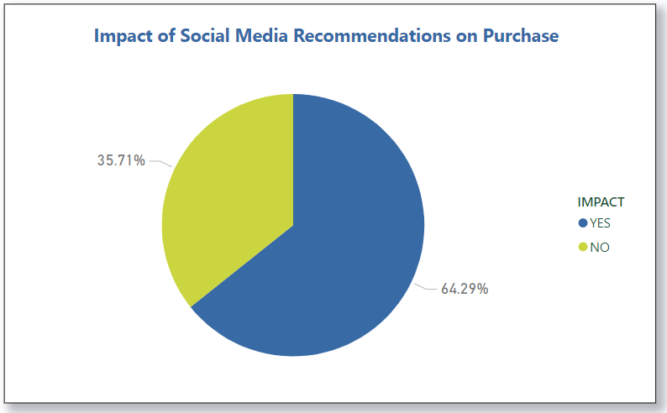
INSIGHTS
IMPACT OF SOCIAL MEDIA RECOMMENDATION
The data clearly shows that most respondents get triggered by social media to purchase goods/services online.
64.29% respondent said yes, 35.17% said no about that social media trigger them to shop online.

Slide 18
FINDINGS
The study discovered that folks aged 20-30 were really into shopping online and spent more time on social media, especially Instagram, Facebook, and YouTube.
Instagram and Facebook turned out to be the top social media choices among respondents.
When it comes to using social media, people are mostly into entertainment and communication. They use the internet to have fun, chat, make friends, gather information, and do some shopping.
More than half of the respondents admitted that social media has a big influence on their decision to buy things.
Online shopping has its perks. The study found that good prices, convenience, a wide variety of products, and the ability to shop 24/7 are the main factors that drive people to shop online.

Slide 19
CONCLUSION
Age and Gender Impact
Reasons for Online Shopping Appeal
The study discovered that age and gender play a role in how people approach online shopping, prompting the need for companies to tailor strategies accordingly.
People are drawn to online shopping due to time and money savings, a wide product selection, trust, and convenience.
Factors like discounts, shipping costs, and privacy significantly influence people's perceptions of online shopping.
Bravery in Online Shopping
Despite potential risks, the research suggests that people are still willing to shop online. This underscores the importance for companies to prioritize safety and security in online shopping experiences.

Slide 20
CONCLUSION
Social Media's Influence
Social media plays a substantial role in influencing people's decisions to buy online.
This implies that companies can use social media as a powerful tool to connect with customers and increase sales.
Global Sales Opportunity
The study emphasizes the vast opportunity for companies, regardless of size or location, to sell products online.
Social media, when used effectively and securely, can be a potent tool, especially for the apparel industry. Companies are advised to focus on understanding online shopping needs and utilizing tools to enhance sales.

Slide 21
THANKYOU

